Slide 1
Constructive Computer Architecture
Arvind
Electrical Engineering and Computer Science
Massachusetts Institute of Technology
6.1920: L01 – February 6, 2024

Slide 2








6.1920 Course Staff
Instructors
Admin
Arvind arvind@csail.mit.edu
Tushar Krishna tushar@csail.mit.edu
Thomas Bourgeat thomas.bourgeat@epfl.ch
Sally Lee sally@csail.mit.edu
Teaching Assistants
Lab Assistants
Martin Chan
martinch@mit.edu
Jianming Tong
jianming@csail.mit.edu
Sanjay Seshan
seshan@mit.edu
Austin White
akwb@mit.edu
For most up-to-date information and handouts please consult Canvas

Slide 3
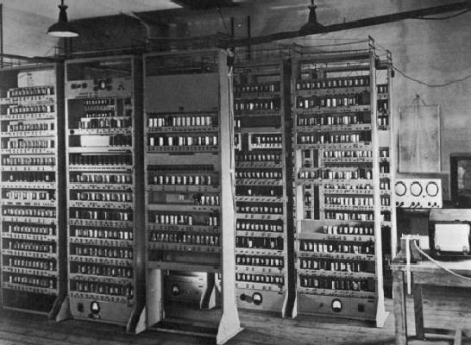
Computing Devices Then… EDSAC, University of Cambridge, UK, 1949
Notes:
Fishbowl computing. Dramatic changes since then.

Slide 4

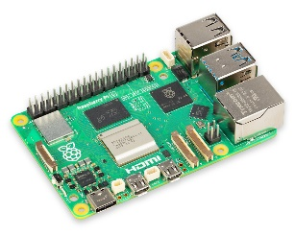

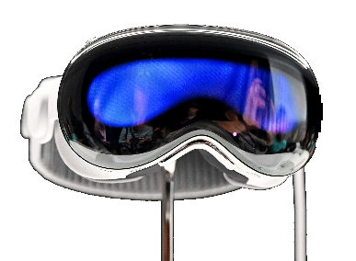

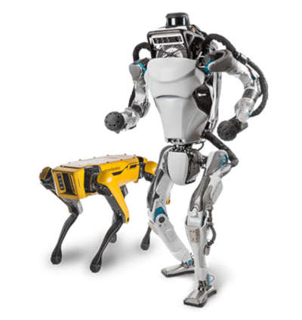
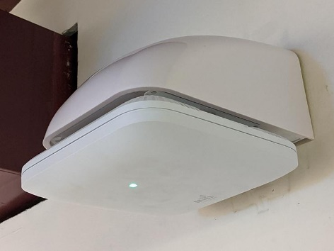
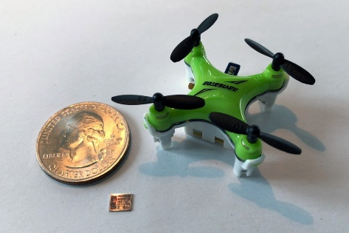
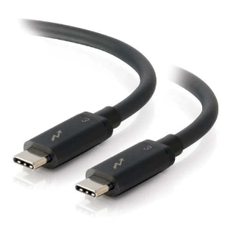
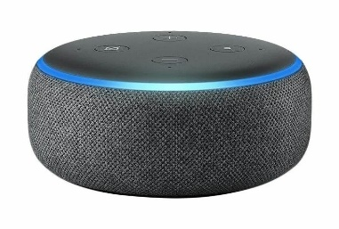




Computing Devices Now
Dramatic progress in terms of size, speed, cost, reliability

Slide 5
Computer architecture is about designing machines to meet some power, performance, cost and size constraints

Slide 6
Studying Computer Architecture
A method of constructing machines: Machine descriptions which can be simulated in software and synthesized into hardware
This course is about “construction”
Quantitative evaluation: To what extent designs meet various design criteria
Testing and verification: Does the machine do what it is supposed to do

Slide 7
The goals of this subject
Study computer architecture by constructing many different machines
Learn a new method of describing architectures where there is less emphasis on diagrams and more emphasis on executable descriptions
Each architecture and each part of it would be defined as executable code in Bluespec System Verilog (BSV)
Learning BSV is about learning a model of parallel programming (all hardware is parallel)
Learn about test benches, including designing your own
Learn about quantitative evaluation of designs

Slide 8
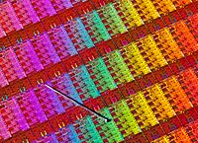
BSV Design Flow
BSV source
Bluespec Compiler
Verilog RTL
Bluespec Simulator
Cycle Accurate
Xilinx Vivado
Simulator
Xilinx Vivado
Synthesis
Design Compiler/ Encounter
VCD output
Power Analysis
Gates
ASIC

Slide 9
All the designs you do in this course can be implemented as ASICs without any changes in the source code. Time will not permit the class to explore ASICs but we will synthesis many designs and study resulting timing and area

Slide 10
Course information
Every week, the class will have :
Two lectures 9:30am-11:00am on Tues and Thurs
One tutorial 3:30pm-5:00pm on Fridays
Lab assignments to be done individually. Each lab will provide ideas for the project
A project in the last two weeks to show and experiment with a cool architectural idea
Grade depends on Labs (70%) + Project (30%)
A = >75%
B = <75%
C = <50%
Late submissions get penalties, project is mandatory
No Quizzes

Slide 11
Resources
BSV Reference manual
“Introduction to Digital Design as Cooperating Sequential Machines”, Arvind, Rishiyur S. Nikhil, James C. Hoe, Silvina Hanono Wachman, 2019
“Computer Architecture: A Constructive Approach”, Arvind, Rishiyur Nikhil, Joel Emer and Murali Vijayaraghavan, 2014 (read chapters 5, 6, 9, 10, 11 and 12 only; there may be inconsistencies with the lectures)
For most up-to-date information and handouts please consult Canvas

Slide 12
Combinational circuits

Slide 13
Combinational circuit
A combinational circuit is a pure function; given the same input, it produces the same output
It can be described using a Truth Table though it is not practical to do so for large number of inputs
Size of truth table for a 32-bit adder?
We will use BSV to describe all circuits in this subject
a
s1
b
f
s2
c
a | b | c | s1 | s2
0 | 0 | 0 | 1 | 0
0 | 0 | 1 | 0 | 0
0 | 1 | 0 | 0 | 0
0 | 1 | 1 | 0 | 1
1 | 0 | 0 | 1 | 1
1 | 0 | 1 | 1 | 0
1 | 1 | 0 | 0 | 1
1 | 1 | 1 | 0 | 0
2³²⁺³² rows

Slide 14
Combinational Arithmetic-Logic Unit (ALU)
func
- Add, Sub, And, Or, ...
ALU performs all the arithmetic and logical functions
a
ALU
result
b
function Data alu(Data a, Data b,
AluFunc func);
Type of a, e.g., Bit#(32)
what does func look like?
Each individual function can be described as a combinational circuit, and these can be combined together to produce a combinational ALU
Notes:
Data could be bit#(32)

Slide 15
Types
A type is a grouping of values:
Integer: 1, 2, 3, …
Bool: True, False
Bit: 0,1
function Integer fname (Integer arg)
Every expression in a BSV program has a type; sometimes it is specified explicitly and sometimes it is deduced by the compiler
Thus, we say an expression has a type or belongs to a type
The type of each expression is unique

Slide 16
User defined Types
Structures (t1 x t2 x …x tn)
typedef struct {
Word x_coord;
Word y_coord; // <- do not forget this ;
} MyStruct deriving (Eq, Bits, FShow);
Enumeration (tag1 + tag2 + … + tagn)
typedef enum {Add, Sub, And, Or, Xor, Nor, Slt, Sltu,
LShift, RShift, Sra} AluFunc deriving(Bits, Eq);
typedef enum {Eq, Neq, Le, Lt, Ge, Gt, AT, NT}
BrFunc deriving(Bits, Eq);
Type synonyms
typedef Bit#(8) Byte;
typedef Bit#(32) Word;

Slide 17
Enumerated types
Suppose we have a variable c whose values can represent three different colors
Declare the type of c to be Bit#(2) and adopt the convention that 00 represents Red, 01 Blue and 10 Green
A better way is to create a new type called Color:
typedef enum {Red, Blue, Green}
Color deriving(Bits, Eq);
Why is this way better?
BSV compiler automatically assigns a bit representation to the three colors and provides a function to test if the two colors are equal
If you do not use “deriving” then you will have to specify your own encoding and equality function
Types prevent us from mixing colors with raw bits

Slide 18
Using an enumerated type: Combinational ALU
function Data alu(Data a, Data b, AluFunc func);
Data res = case(func)
Add : addN(a,b);
Sub : subN(a,b);
And : andN(a,b);
Or : orN(a,b);
Xor : xorN(a,b);
Nor : norN(a,b);
Slt : zeroExtend(pack(signedLT(a,b)));
Sltu : zeroExtend(pack(lt(a,b));
LShift: shiftLeft(a,b[4:0]);
RShift: shiftRight(a,b[4:0]);
Sra : signedShiftRight(a,b[4:0]);
endcase;
return res;
endfunction
Given an implementation of the primitive operations like addN, Shift, etc. the ALU can be implemented simply by introducing a mux controlled by func to select the appropriate circuit
Notes:
Slt, Sltu?

Slide 19
Using an enumerated type: Comparison operators
function Bool aluBr(Data a, Data b, BrFunc brFunc);
Bool brTaken = case(brFunc)
Eq : (a == b);
Neq : (a != b);
Le : signedLE(a,b);
Lt : signedLT(a,b);
Ge : signedGE(a,b);
Gt : signedGT(a,b);
AT : True;
NT : False;
endcase;
return brTaken;
endfunction
Notes:
19
We only compare with 0?

Slide 20
Integer versus Bit#(32)
In mathematics integers are unbounded but in computer systems integers always have a fixed size
BSV allows us to express both types of integers, though unbounded integers are used only as a programming convenience
for(Integer i=0; i<32; i=i+1)
begin
let cs = fa(x[i],y[i],c[i]);
c[i+1] = cs[1]; s[i] = cs[0];
end
integer

Slide 21
Type declaration versus deduction
The programmer writes down types of some expressions in a program and the compiler deduces the types of the rest of expressions
If the type deduction cannot be performed or the type declarations are inconsistent, then the compiler complains
function Bit#(2) fa(Bit#(1) a, Bit#(1) b,
Bit#(1) c_in);
Bit#(2) ab = ha(a, b);
Bit#(2) abc = ha(ab[0], c_in);
Bit#(2) c_out = ab[1] | abc[1];
return {c_out, abc[0]};
endfunction
type error?
Type checking prevents lots of silly mistakes

Slide 22
Assigning to Bitvector elements
Bit#(3) c=0;
Means c is three bits wide and each element is set to zero
Element 0 of c is connected to 0 but the value of the rest of the elements is not affected
Initial value of a vector must be set; we use “?” if we don’t know the initial value
c[0] = 0;

Slide 23
2-bit Ripple-Carry Adder cascading full adders
x[0]
y[0]
x[1]
y[1]
fa
c[1]
fa
Use fa as a black-box
c[0]
c[2]
s[0]
s[1]
add(x, y, c0):=
c[1], s[0] = fa(x[0], y[0], c[0]);
c[2], s[1] = fa(x[1], y[1], c[1]);
return {c[2],s};

Slide 24
w-bit ripple carry adder
x[0]
y[0]
x[1]
y[1]
x[w-1]
y[w-1]
fa
c[1]
fa
c[2]
c[w-1]
fa
c[w]
c[0]
…
s[0]
s[1]
s[w-1]
c[1], s[0] = fa(x[0], y[0], c[0]);
c[2], s[1] = fa(x[1], y[1], c[1]);
…
c[w], s[w-1] = fa(x[w-1], y[w-1], c[w-1]);
Tedious to write such repetitive equations

Slide 25
Write a loop and unfold it using a compiler!
for(i=0; i<w; i=i+1)
c[i+1], s[i] = fa(x[i],y[i],c[i]);
return {c[w], s}
Can be done only when the value of w is known
c[1], s[0] = fa(x[0], y[0], c[0]);
c[2], s[1] = fa(x[1], y[1], c[1]);
…
c[w], s[w-1] = fa(x[w-1], y[w-1], c[w-1]);
“for” is *NOT* a loop like in python. It is just a shortcut to avoid having to write many lines. This fake loop has to be fully unrolled by the compiler.

Slide 26
Combinational ALU
a
b
…
Eq
LShift
…
Add
func
mux

Slide 27
Complex Combinational Circuits

Slide 28
Multiplication by repeated addition
b Multiplicand
a Muliplier *
1101 (13)
1011 (11)
0000
x 1101
1101
+ 1101
+ 0000
+ 1101
10001111 (143)
At each step we add either 1101 or 0 to the result depending upon a bit in the multiplier
mi = (a[i]==0)? 0 : b;
m0
m1
m2
m3
We also shift the result by one position at every step
However, our addN circuit adds only two numbers at a time!

Slide 29
Multiplication by repeated addition cont.
b Multiplicand
a Muliplier *
tp
m0
tp
m1
tp
m2
tp
m3
tp
1101 (13)
1011 (11)
0000
+ 1101
01101
+ 1101
100111
+ 0000
0100111
+ 1101
10001111 (143)
At each step we add either 1101 or 0 to the result depending upon a bit in the multiplier
mi = (a[i]==0)? 0 : b;
We also shift the result by one position at every step
Notice, the first addition is unnecessary because it simply yields m0

Slide 30
Multiplication by repeated addition ckt
a0
m0
0 0 0 0
b Multiplicand
a Muliplier *
tp
m0
tp
m1
tp
m2
tp
m3
tp
1101 (13)
1011 (11)
0000
+ 1101
01101
+ 1101
100111
+ 0000
0100111
+ 1101
10001111 (143)
add4
a1
m1
add4
a2
m2
add4
a3
m3
mi = (a[i]==0)? 0 : b;
add4

Slide 31
Combinational 32-bit multiply
function Bit#(64) mul32(Bit#(32) a, Bit#(32) b);
Bit#(32) tp = 0; Bit#(32) prod = 0; for(Integer i = 0; i < 32; i = i+1) begin Bit#(32) m = (a[i]==0)? 0 : b; Bit#(33) sum = add32(m,tp,0); prod[i] = sum[0];
tp = sum[32:1];
end return {tp,prod}; endfunction
This circuit uses 32 add32 circuits
Lot of gates!
Can we do better?
Stay tuned…
Long chains of gates
32-bit multiply has 32 ripple carry adders in sequence!
32-bit ripple carry adder has a 32-long chain of gates
Total delay ?
2n FA delays, not nxn
why?
2(n-1) FAs?
Notes:
Iteration I produces the ith bit of answer using only i FAs. The most significant 32 bits are produced in the last step which involves an additional 32FA delays

Slide 32
BSV Compiling phases
Type checking: Ensures that type of each expression can be determined uniquely; Otherwise, the program is rejected
Static elaboration: Compiler eliminates all constructs which have no direct hardware meaning
Loops are unfolded
Functions are in-lined; even recursive functions can be used as long as all the recursion can be gotten rid of at compile time
After this stage, for example, the program does not contain any Integers because Integers are unbounded in BSV
Gates are generated (actually Verilog)

Slide 33
Takeaway
Once we define a combinational ckt, we can use it repeatedly to build larger ckts
The BSV compiler, because of the type signatures of functions, prevents us from connecting them in obviously illegal ways
We can write parameterized ckts in BSV, for example an n-bit adder. Once n is specified, the correct ckt is automatically generated
Even though we use loop constructs and functions to express combinational ckts, all loops are unfolded, and functions are inlined during the compilation phase

